Slide 1

WIRELESS SENSOR NETWORKS & APLLICATIONS
Department of Computer Science And Engineering
19 CSE 101 - Computer System Essentials
2021-25 Batch
[SEMESTER-1]
GROUP -13 WELCOMES YOU !!!

Slide 2
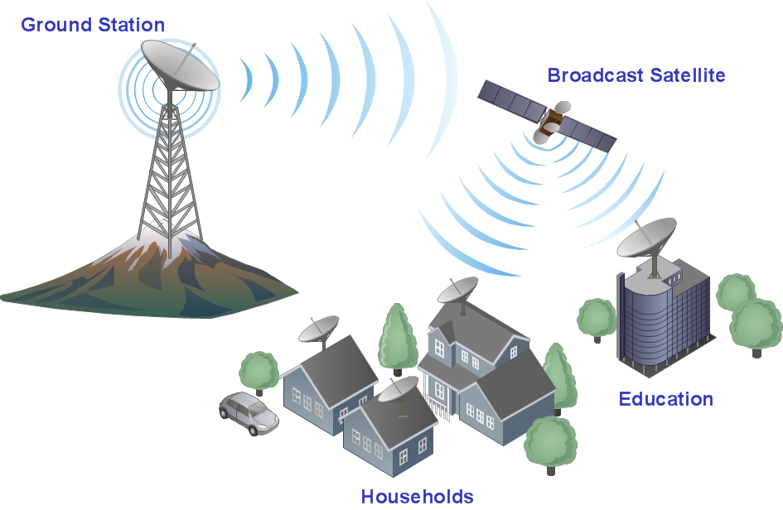
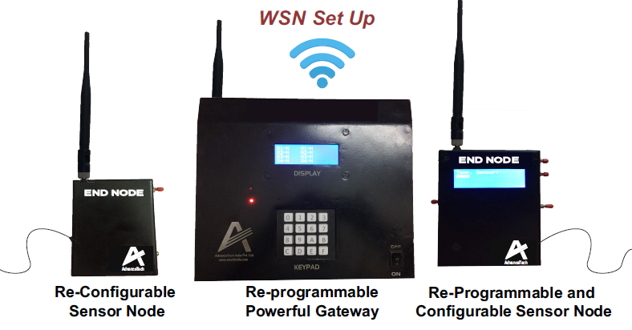
INTRODUCTION
This is mostly used to measure temperature, sound, humidity and many more. They mostly rely on wireless connectivity and spontaneous net for transportation of data wirelessly.
This is mostly used to measure temperature, sound, humidity and many more.They mostly rely on wireless connectivity and spontaneous net for transportation of data wirelessly.
Wireless sensor and network application is networks of spatially dispersed and dedicated sensors that monitors and records the conditions around and forwards the data to the central location. The output of the sensor is generally an electric signal that is transmitted to a controller for further processing.

Slide 3
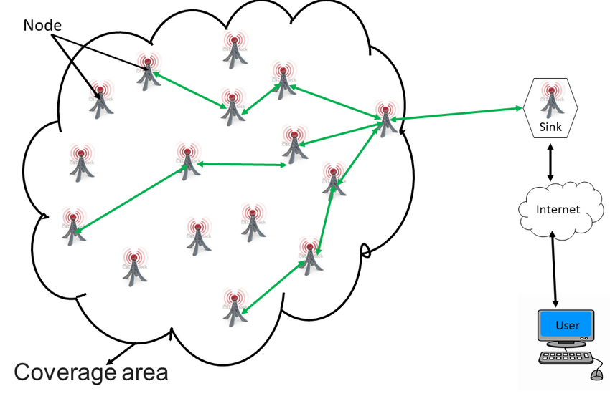
types and details of wsn
WSN
Multimedia
&
Mobile
TERRESTRIAL
UNDERGROUND
UNDERWATER

Slide 4
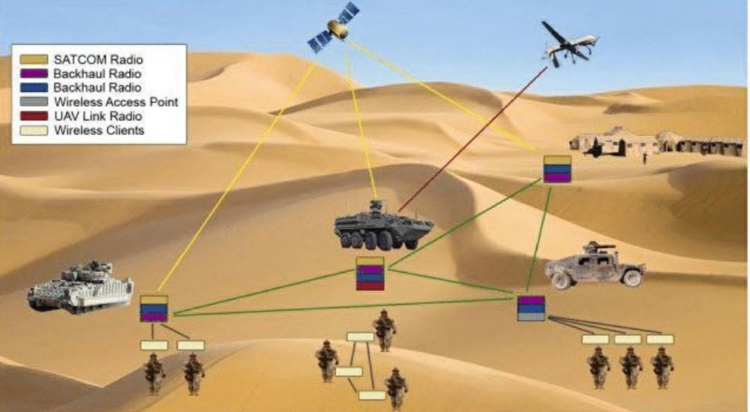
APPLICATIONS OF WSN
Military surveillance and target tracking
WSN’s can be rapidly deployed for surveillance and used to provide battlefield intelligence regarding location,murder movement and identity of troops and vehicles and for detection of chemical,biological and nuclear weapons.
Water quality monitoring
It involves analyzing water properties in dams,rivers,lakes and oceans as well as underground water reserves. The use of many wireless distributed sensors enables the creation of a more accurate map of water status and allows the permanent deployment of monitoring stations in locations of difficult access,without the need of manual data retrieval.

Slide 5
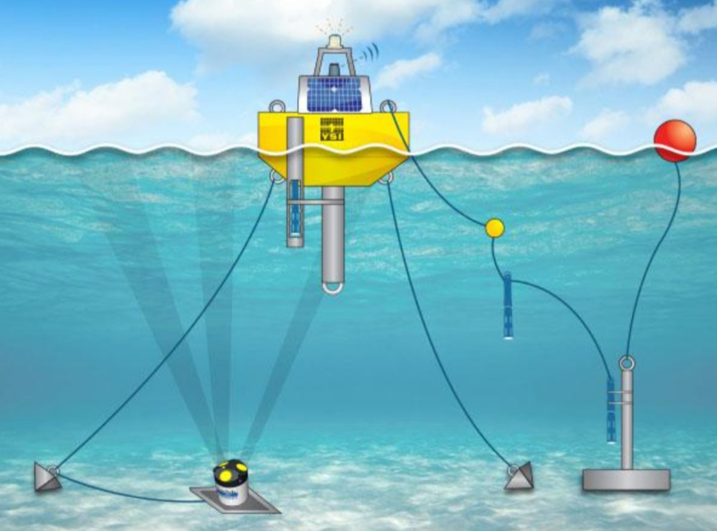
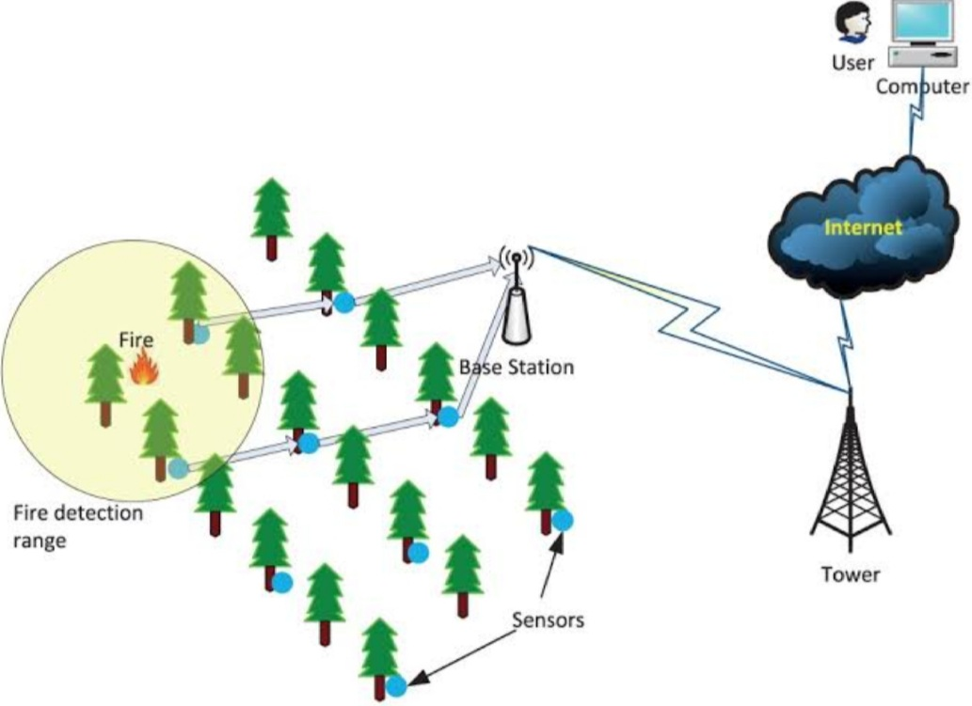
APPLICATIONS OF WSN
Parameters considered includes -temperature turbidity and pH.
Forest fire detection

Slide 6
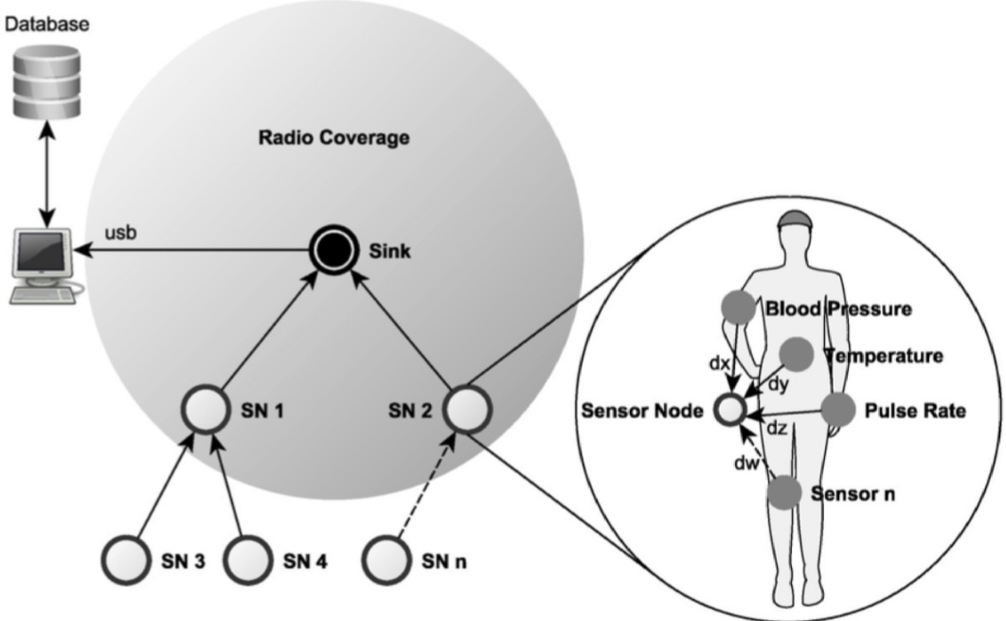
APPLICATIONS OF WSN
A network of sensor nodes can be installed in a forest to detect when a fire has started. Sensor nodes measures temperature, humidity and gases which are produced by fire in the trees.If the nodes detects fire it sends an alarm message along with its location to the base station.
Health monitoring
WSNs can be embedded into a hospital building to track and monitor patients and all medical resources. There are various kinds of sensors which can measure,
*Blood pressure
*body temperature
*ECG.

Slide 7

ADVANTANGES
Avoids a lot of wiring …
Can accommodate new devices at any time..
Flexible to go through physical properties..
It can be accessed through a centralized monitor
Much cheaper to deploy than wired sensor…
Sensor nodes can be added or removed easily..
Node location can be changed without rewiring
Can be configured into different network topologies

Slide 8
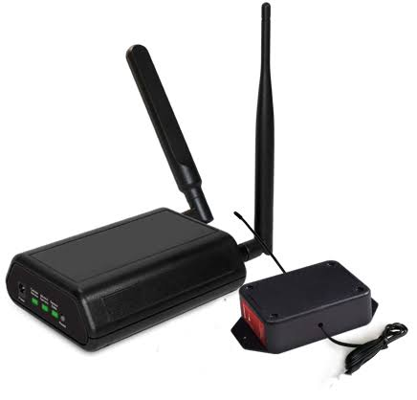
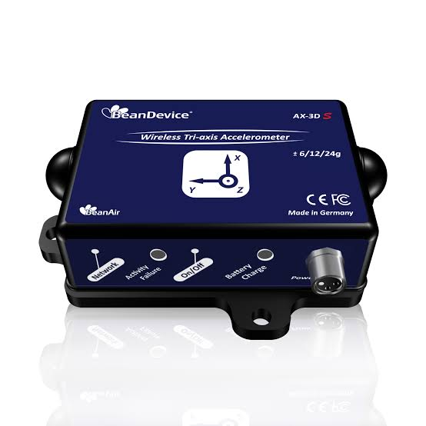
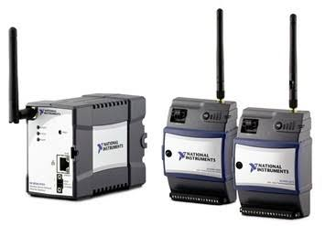
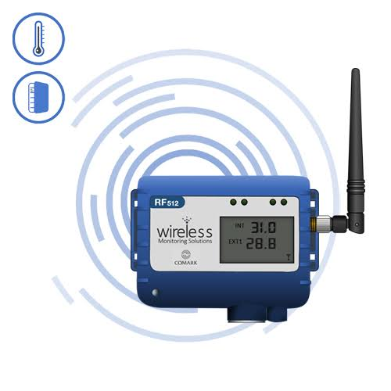
MERITS
Wireless monitoring WSN for harsh Wireless Measuring Wireless Temper-
&Data logging kit Environment Device selection guide ature Transmitter
Wireless sensor networks are used in those harsh and hostle environments where wired networks can’t be deployed
The wireless sensor networks was valued at USD46.76.Billion in 2020 and in expected to reach USD129.3 Billion by 2026, at a CAGR of 17.64./. Over the forecast period 2021-26

Slide 9
DISADVANTAGES
It is very easy for hackers to hack it as we cant control propagation of wave ,comparatively low speed of communications.
Gets distracted by various elements like blue-tooth , Still costly at large.
Sensor networks are a relatively new technology, and while many of the initial use cases show promise that WSNs will succeed, there are still some barriers to overcome.

Slide 10

DISADVANTAGES
➢It can not be used for high speed communication as it is designed for low speed applications.
➢It is expensive to build such network and hence can not be affordable by all.
n star topology based WSN, failure of central node leads to whole network shutdown.
It may be large and span a wide area, meaning that there are many sensor nodes that could serve as an access point to the network for a malicious attacker.

Slide 11

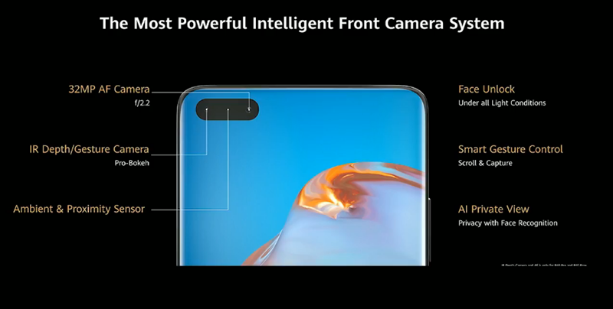
Devices &products
DEVICE : HAUWEI – P40 PRO[mobile]
RELEAESED ON: MARCH 2020
HIGHLIGHTS: We can control the mobile by standing 20-25cm away from that mobile with the help of wireless sensor[1/1.33-inch] located at the portion of front camera.

Slide 12
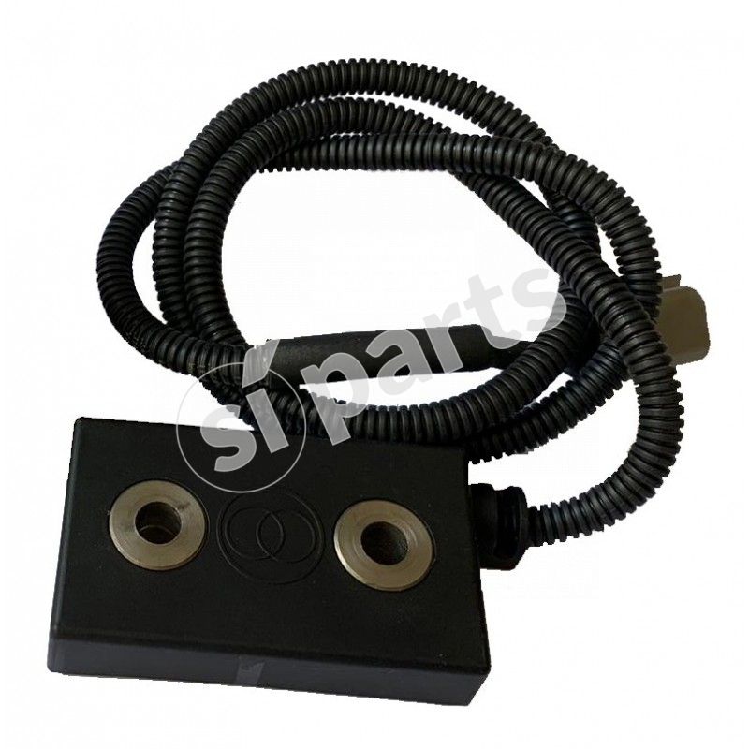
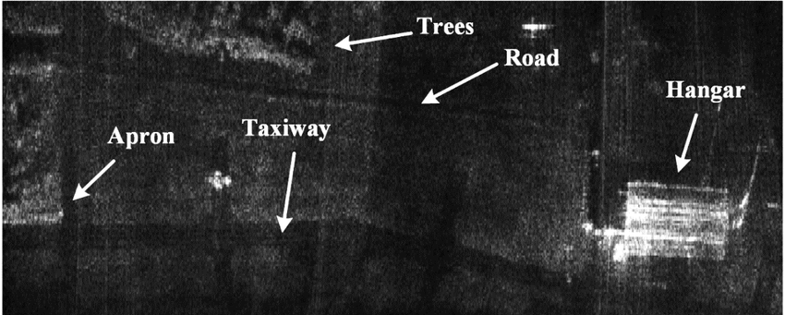

conclusion
Synthetic Aperture Radar or SAR is an electromagnetic imaging sensor often used in remote sensing applications.
> Mostly used in the military
to Detect the fog smog and dust.
Wireless sensors and its networking systems are widely used in many applications like A.I AND IOT and many more …

Slide 13

Thank you !!!
CSE-A
GROUP-13
VAISHNAVI
SUSEELA
HARSHA
VIGNESH
VINAY

